Slide 1
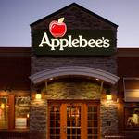
Applebee’s Restaurant Gets Ahead of Competition
Utilising Root Cause Analysis to figure-out the reason behind Applebee’s downward revenue trend.
&
Decision Tree to showcase possible alternatives and proffer solution for a business Turnaround

Slide 2
Scenario
My client is the owner of an Applebee’s franchise restaurant in the small town of Shelton, Connecticut (population ~ 42,000 as of 2022 census). The Applebee’s concept focuses on casual dining, with mainstream American dishes such as sandwiches, burgers, salads, shrimp and Pasta.
Problem Statement
Recently, the Shelton Applebee’s restaurant’s revenues are trending downward, but costs are stable. Therefore, profits are shrinking quickly.
Task:
(1) find the cause of the issue, (2) help turn around the business.

Slide 3
Application of the 5 Why Technique
Why are profits shrinking? Revenues are declining, but costs are stable, so there is less income to cover the fixed expenses.
Why are revenues declining? Fewer customers are dining at the restaurant compared to previous periods.
Why are fewer customers dining at the restaurant? The restaurant may not be attracting enough new customers, and some regular customers might have stopped coming as often.
Why isn’t the restaurant attracting new customers, and why are regulars not returning? The restaurant is failing to meet customer expectations and there may also be increased competition from other restaurants, or changing dining trends in the community (e.g., more people choosing healthier options, fast-casual, or home delivery services).
Why is the restaurant failing to meet customer expectations or losing to competition?
The marketing efforts may not be sufficient to reach the local population, especially with new competitors or shifts in customer preferences (e.g., preference for online orders or delivery services that Applebee’s isn’t adequately promoting).

Slide 4
Root Cause
There are no changes in customer tastes. The client’s menu, food quality, service and suppliers are all the same.
The main cause in the sales drop is a new competitor “FinerFoods” Restaurant that just opened across the street. “FinerFoods” Restaurant is a fast food “plus” style restaurant that serves not only traditional fast food (sandwiches, burgers), but also a broader menu (chicken, pasta, burritos). “FinerFoods” Restaurant offers online orders and delivery services.

Slide 5
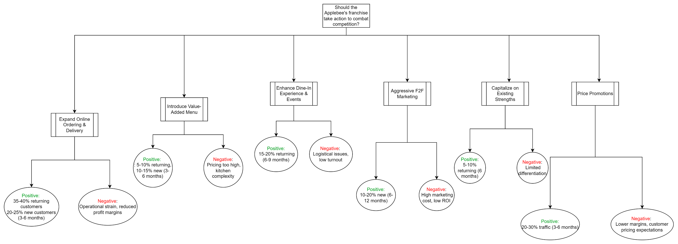
Decision Tree showing solution alternatives

Slide 6

Solution Implementation
Based on the root cause identified, the restaurant introduced online ordering and delivery service with exclusive promotions like exclusive dishes available at 25% off, only for online orders to increase engagement with the service. It also introduced loyalty programs with aggressive F2F marketing with the aim of reaching out to a huge majority of the 42000 of the community’s population; offering Price Promotions to win price-sensitive customers.

Slide 7

Impact
Implementing these changes led to a 35 – 40% increase in Returning Customers over 3-6 months and a 20-25% increase in New Customers over the same period.

